Slide 1
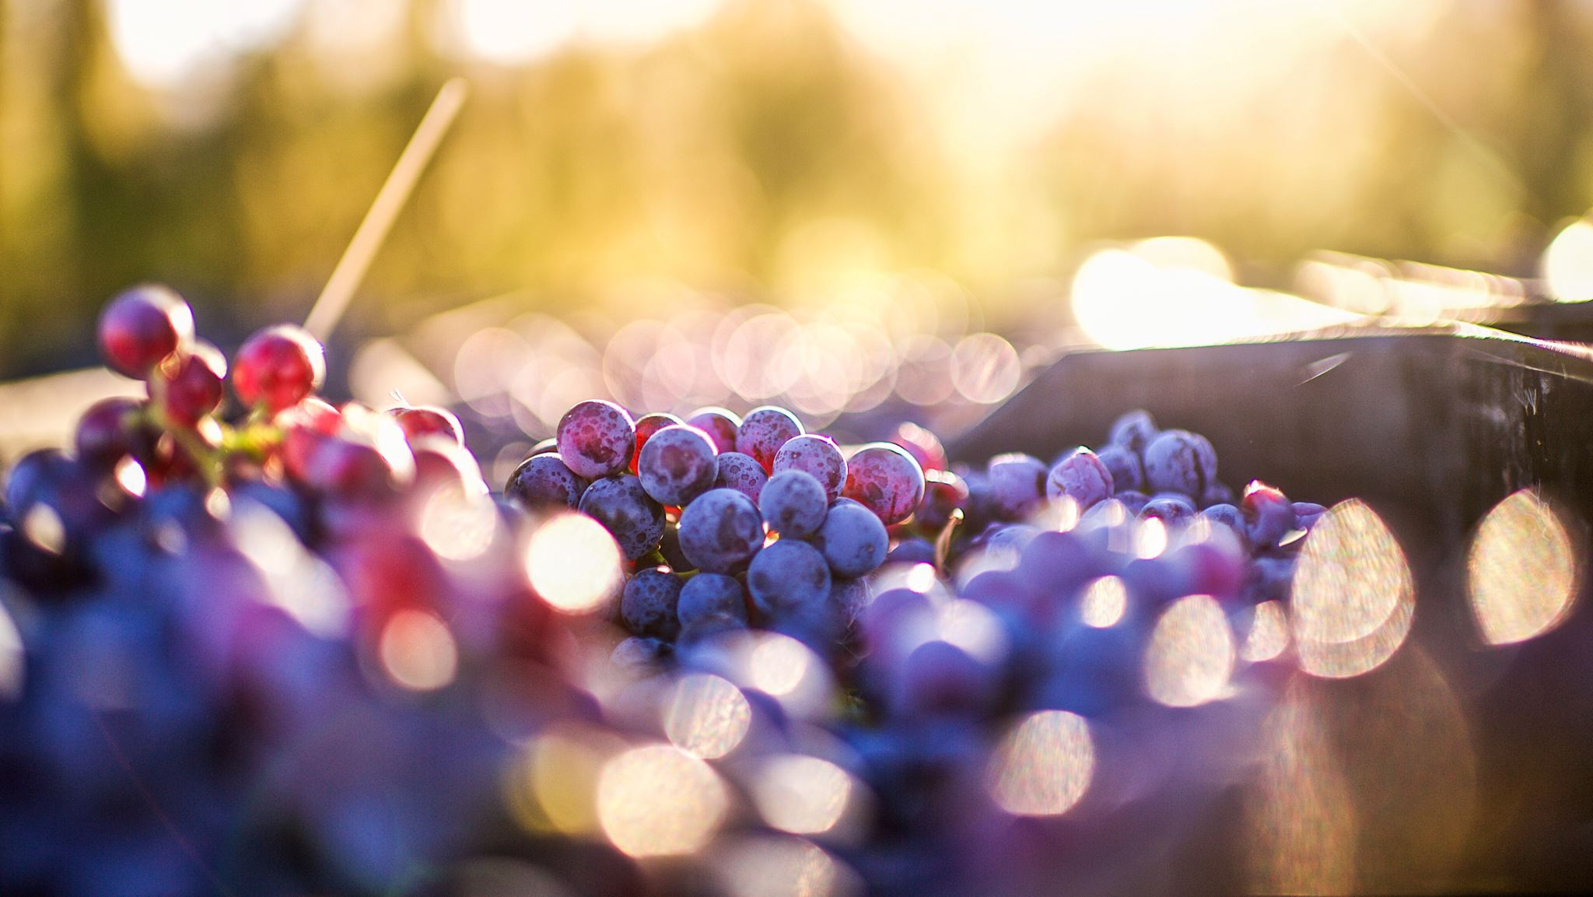
Red Wine Quality Prediction
Capstone Project Submission
(SCTP) ASSOCIATE DATA ANALYST: CAPSTONE PROJECT – PROJECTS
MR TEO KIM SONG - VLC-SCADF11-25-0655 01/08/2025 - 21/08/2025

Slide 2
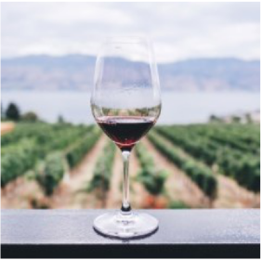
Problem Statement
Client/Scenario: A Portuguese winery wants to improve wine quality control.
Business Problem: Current quality evaluation is manual, costly, and subjective.
Project Objective: Build a data-driven model to predict wine quality based on chemical tests.

Slide 3
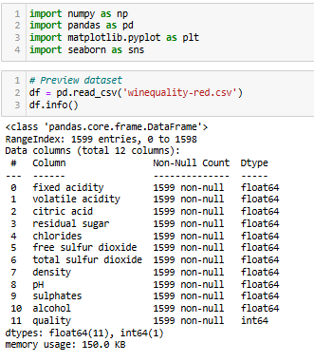
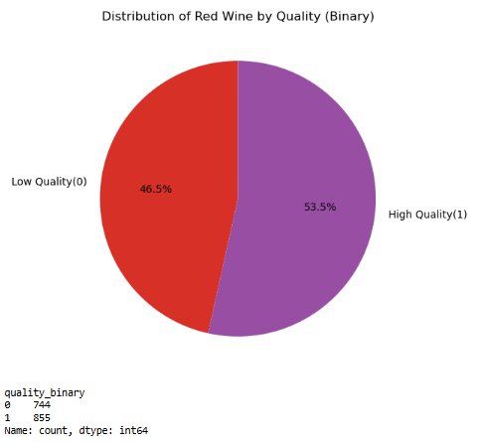
Dataset Overview
Source: UCI Machine Learning Repository – Wine Quality Dataset
Source: UCI Machine Learning Repository – Wine Quality Dataset
Total Records: 1,599 red wine samples
Features: 11 physicochemical properties (e.g., alcohol, acidity) & 1 target quality
Target Variable: Wine quality score (0–10), rated by human testers
Data Format: Clean and complete – no missing values
Binary Classification: Quality transformed
0 = Low (quality ≤ 5)
1 = High (quality ≥ 6)
Pie Chart shows percentage of High vs. Low quality wines

Slide 4
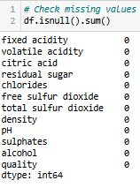
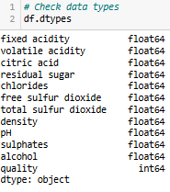
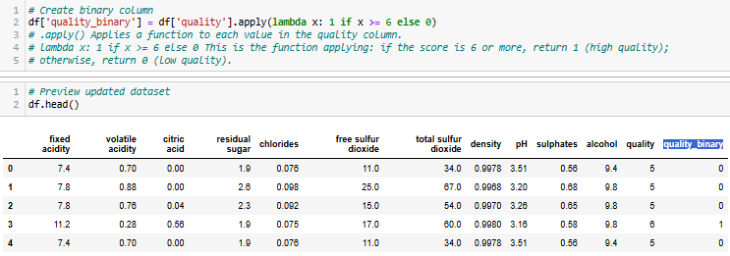
Data Cleaning & Preparation
No missing values found
Corrected data types (all numerical features)
Created a new column: quality_binary
0 = Low quality (score ≤ 5)
1 = High quality (score ≥ 6)
Ready for modeling and visualization
Rounded float values (e.g., chlorides, density) to 4 decimal places for clarity

Slide 5

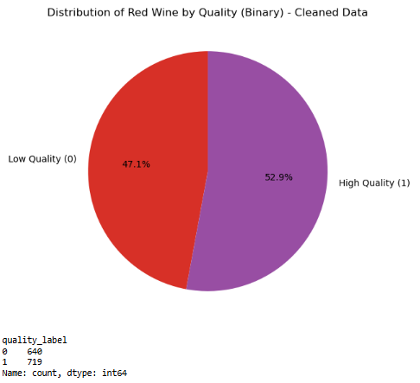
Feature Engineering
Data Cleaning Context:
Original dataset size1599 rows
Removed duplicate rows to ensure dataset quality
Final dataset size: 1359 unique rows remain
Target Variable Creation:
Converted original wine quality scores into binary labels:
0 → Low Quality Wine (score ≤ 5)
1 → High Quality Wine (score ≥ 6)
Simplifies the model to a binary classification task
Class Distribution:
Pie chart illustrates proportion of low vs high quality wines in the cleaned dataset
Balanced enough for modeling

Slide 6
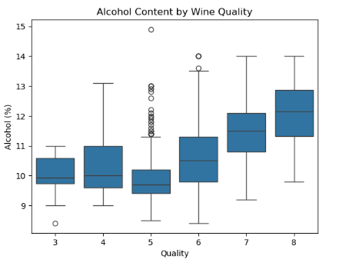
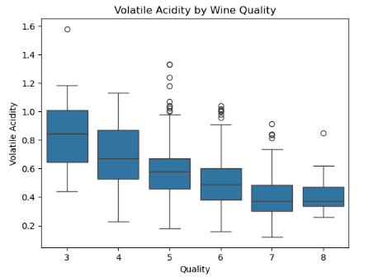
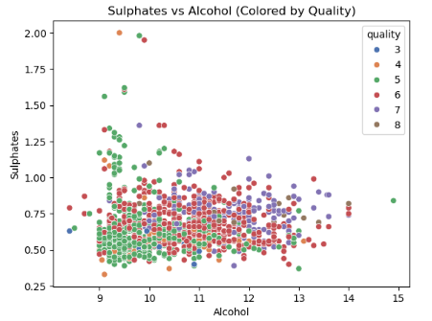


Exploratory Data Analysis (EDA)
Alcohol vs Quality (boxplot)
Volatile Acidity vs Quality (boxplot)
Sulphates and Alcohol (scatter plot)

Slide 7
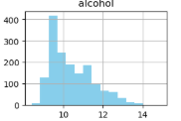
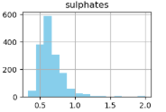
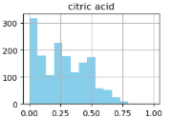
Business Recommendations
Focus on optimizing alcohol, sulphates, and citric acid levels.
Minimize volatile acidity to improve quality.
Use model predictions for early quality control in production.
Future work: Multi-class prediction, more features, and model comparison.

Slide 8
Documentation & Recommendations
Final Report: Red Wine Quality Analysis & Prediction
1. Project Overview
This project analyzed physicochemical properties of red wine to build a classification model predicting wine quality. Using data from the UCI Wine Quality dataset, we explored relationships between features and quality and developed a Random Forest classifier to categorize wines as good or bad.
2. Key Findings from EDA
Wine quality scores mainly range between 3 and 8, with most wines rated 5 or 6.
Alcohol content positively correlates with wine quality; higher alcohol often means better wine.
Volatile acidity negatively correlates with quality; wines with higher acidity tend to be rated lower.
No missing data was found; dataset was clean and suitable for modeling.
3. Model Performance
The Random Forest model achieved an accuracy of ~81%, with balanced precision and recall.
Confusion matrix and ROC curve indicate good discrimination between High quality and Low quality wines.
Feature importance highlighted alcohol, sulphates, and volatile acidity as key predictors.
4. Business Recommendations
Winemakers should monitor and optimize alcohol content to enhance wine quality.
Reducing volatile acidity levels can improve taste and ratings.
Regular chemical profiling during production can help maintain consistent quality.
The predictive model can be used as a quality control tool to flag potential issues early.
5. Limitations and Next Steps
The model is binary classification; future work could explore multi-class classification to predict exact quality scores.
Incorporate additional features such as grape type or vineyard region for richer analysis.
Deploy the model in a user-friendly app or dashboard for winemakers’ real-time use.

Slide 9







Tools Used / Acknowledgements These tools were used to handle, analyse, and visualize the data efficiently.
• Python (Jupyter Notebook) – Coding and data analysis
• NumPy & Pandas – Data wrangling and cleaning • Seaborn & MatplotLib – Data visualization • PowerPoint – Presentation design & delivery
• Microsoft Word – Step-by-step analysis documentation
Special thanks to my trainer, Mr. Bishmer, for his guidance and support throughout this project.

